Slide 1
Basic Concept
Sarower Ahmmed

Slide 2


Slide 3
My Need?
To Buy a house
Its called concept or need in IT world

Slide 4


Your dream house?

Slide 5
Dream house Criteria in detail- Requirement
………
…….........
…………………..
………………………
……………………………..
……………………………………………………..
…………………………………………………………….
………………………………………………………………………

Slide 6


Slide 7
You should need some ability to buy dream house
Financial ability
……………….
………………………..
…………………………….
………………………………………

Slide 8
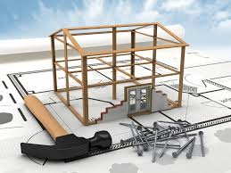
If you want custom build house: Need Design from architecture /design team

Slide 9

Need a team of construction worker to build Dream house

Slide 10
If you buy ready house :: like
3rd party application or software
  No need own design team
  No need development

Slide 11
When development done or before buy: need to check as it fulfill your requirement-
Testing

Slide 12
Repaired and maintenance your dream house if required

Slide 13
SDLC
Stages:
Concept
Requirement
System design
Coding/ Development
Testing
Implementation & maintenance
PAPER BASED
HANDS
ON

Slide 14
QA responsibility in SDLC
Responsibility | Stages
No active involvement, But can Participate on meetings, | Concept
Read requirement document try to understand as requirement : Clear, Consistence and Testable | Requirement
Read design document, Writing test cases based on design prototype of application | Design Stage
Black box tester not active but White box tester do unit testing. | Development Stage
All testing need to do in this stage with manage Defect Life cycle | Testing Stage
Do regression test if any update version or defect fix | Implementation & Maintenance

Slide 15
STLC stages: SDLC stages
Concept
Req
System design
Code/ Development
Testing
Implementation & maintenance
Req analysis
Test Development
  Test plan
  Test case
  Test data
  RTM
  Executed
  Defect manage
  Test reporting
On PAPER
Pass
Fail

Slide 16
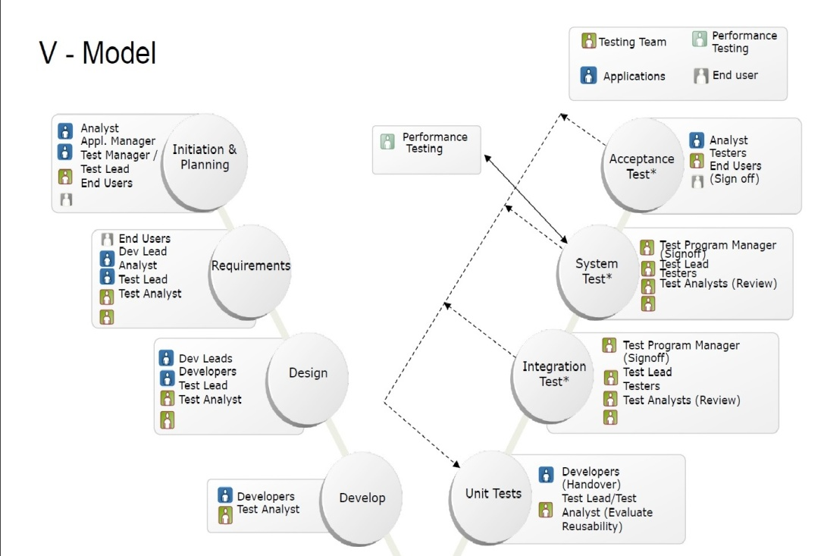
V model:
Two things:
Lt side > verification. Rt side > validation

Slide 17
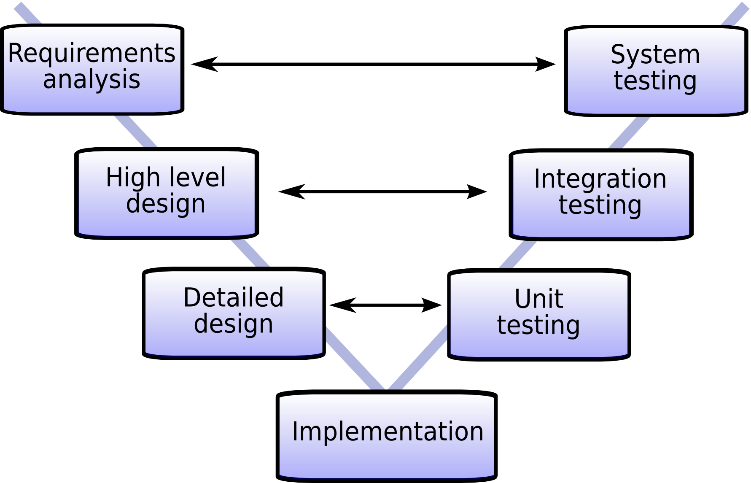

Slide 18
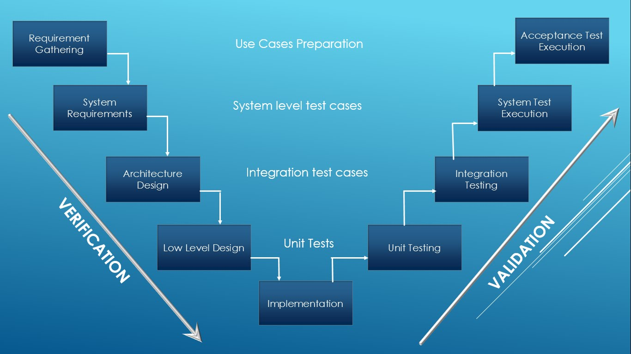

Slide 19
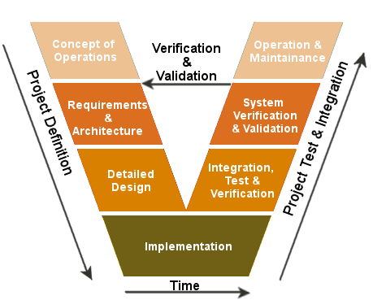

Slide 20
Methodology:
A standard/guideline how to follow the stages.
Types:
Waterfall
Iterative
Agile
Purpose:
Faster
Better
Cheaper

Slide 21
6 to 12 ms
Govt. org
Always change req
Agile
3 ms
Real time communication
FASTEST
2 wks
Methodology
Waterfall
Iterative

Slide 22
Waterfall
The oldest.
Must be sequential-Waterfall Model is a flow based model, in which we pass every phase once, and can not go back to that phase again.
Type:
Flexible waterfall: requirement system design.
Stick waterfall-
  Can’t go back and front,
  Can’t change the requirement.
Disadvantage:
Long wait time> 6 to 12 months=> private comp not use.
Advantage: If we know what customer requirement>then its best to use.

Slide 23
Iterative
Build a system with increment.
We can changes the requirement-we can always come back to previous phases, and make the changes accordingly.
Example:
Supposed we have 400 requirements
  Waterfall=>> all 400 will be done in 1 yr
Here:
400
All stages
3 months
All stages
3 months
100
100
100
100
All stages
3 months
All stages
3 months

Slide 24
Agile Methodology:
Mostly used.
More atomic but its a similar type of Iterative
It can deliver within 2 wks =>> So its FASTER
Handle less number of requirements.
Real-time communication:
  Less documents
  1 developer for 1 tester for 1 business analysis

Slide 25
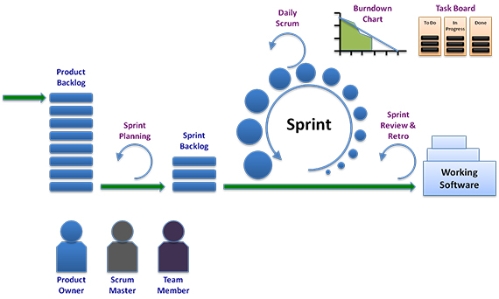

Slide 26

Dev: Tester= 3:1
Manager
Lead
Automation Tester
Manual Tester
Developer
Tester
Agile Team Members
Scrum Master=1
Product Owner=1
Design
ETL/DBA
BA=1
Project manager Head of Project

Slide 27
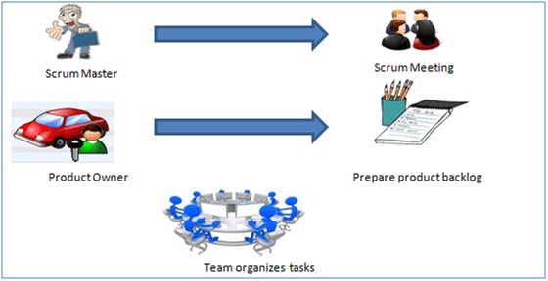


Slide 28
Daily Scrum Meeting:
Called Daily Standup meeting
Scrum meeting held every day and always 3 Qs and time 10 to 15 mints:
What did u do yesterday?
What will u do today?
Any major issue that requires escalation?

Slide 29
PBI=Product back lock Items
All requirement
  High
  Medium
  Low
PO=Product owner responsible to tell PBI with ranking as High>medium>low
Break each PBI into Tasks / Items: not more than 5 tasks
  Task 1: Design related------Assign to One in deign team
  Task 2: Development related-------Assign to one Dev
  Task 3: Data analysis-------------Assign to ETL
  Task 4: Testing-----------------Assign to tester

Slide 30
Sprint= Time frame to complete certain PBI or requirement
Standard sprint 2 to 4 wks
Usually take 2/3 PBI in one sprint
How to select number/Story point of PBI=>
  By poker play by Agile team member
Which PBI to be taken in sprint=> usually take High level PBI
  By a meeting with
    SM
    PO/BA
    All manager & Lead

Slide 31
Meeting in Sprint
Sprint planning- sprint start with this meeting
Sprint review/Retrospective meeting- sprint end with this meeting
  If 2 wks sprint ::
    Sprint planning- On Monday
    Sprint review/Retrospective meeting- On Friday
Daily Scrum – every day 15 mints
Mid-sprint meeting – may or may not => middle of two wks

Slide 32


Slide 33
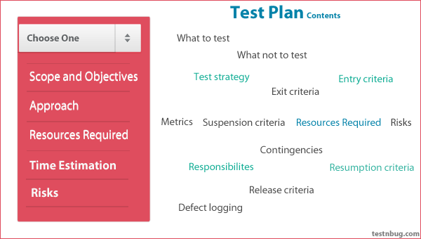
Test Plan

Slide 34
PBI | Sprint backlog | Roll over
All requirements in a project | Requirements/PBI: those taken in a sprint | Leftover work from one sprint to next sprint

Slide 35
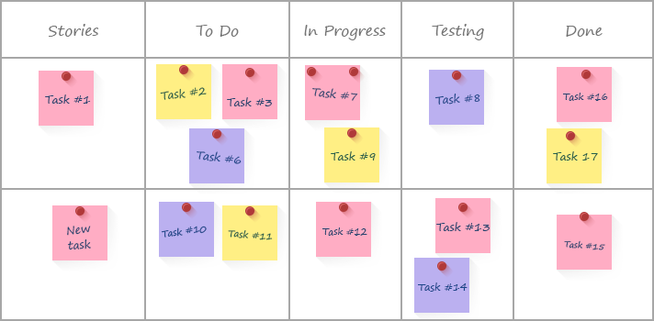
Time Estimation in Sprint
If 2 wk sprint:
  Total 10 days:: 7 hrsx10=70 hrs
  Estimate time for each PBI task or item by your self

Slide 36
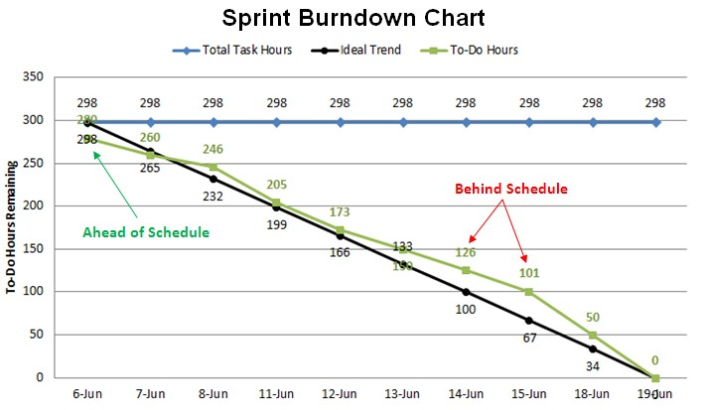
How to check Team status in Sprint:

Slide 37
Epic>Feature>Story/task/item
Epic
- Allow the customer to manage its own account via the Web
Feature
- Editing the customer information via the web portal
User story
As bank clerk,
I want to be able to modify the customer information
so that I can keep it up to date.

Slide 38
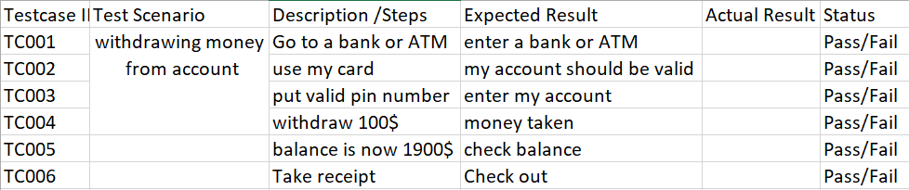
Agile /User Story: I withdraw 100$ from my account and balance is now 1900$
Test case:
Feature: Account balance check
Scenario : Withdrawing money
Given I have 2000$ in my bank account
When I withdraw 100$
Then I receive 100$ in cash
And my balance is 1900$
Cucumber with BBD- Gherkin Language

